Slide 1



Slide 2


01AI0303 - Database Management Systems
Unit - 1
Introductory concepts of DBMS
Prepared by
Prof. Premavathi T
Computer Engineering – AI

Slide 3



Outline
Introduction of DBMS
Applications of DBMS
Advantages of DBMS
Basic terms
Data models
Three levels ANSI SPARC database system
Data Abstraction in DBMS
Mappings and data independence
Database users and DBA
Database system architecture

Slide 4

Introduction of DBMS

Slide 5
What is Database Management System (DBMS)?
Data - Fact that can be recorded or stored
e.g. Person Name, Age, Gender and Weight etc.
Database - Collection of logically related data
e.g. Books Database in Library, Student Database in University etc.
Management - Manipulation, Searching and Security of data
e.g. Viewing result in MU website, Searching exam papers in MU website etc.
System - Programs or tools used to manage database
e.g. SQL Server Studio Express, Oracle etc.
DBMS - A Database Management System is a software for creating and managing databases.
Database Management System (DBMS) is a software designed to define, manipulate, retrieve and manage data in a database.
e.g. MS SQL Server, Oracle, My SQL, SQLite, MongoDB etc.

Slide 6

Applications of DBMS

Slide 7
Applications of DBMS
DBMS is a computerized record-keeping system.
DBMS is required where ever data need to be stored.
E-Commerce (Flipkart, Amazon, Shopclues, eBay etc...)
Online Television Streaming (Hotstar, Amazon Prime etc...)
Social Media (WhatsApp, Facebook, Twitter, LinkedIn etc...)
Banking & Insurance
Airline & Railway
Universities and Colleges/Schools
Library Management System
Human Resource Department
Hospitals and Medical Stores
Government Organizations
Exercise
Write down any five applications of DBMS other than above.

Slide 8
Advantages of DBMS

Slide 9

Reduce data redundancy (duplication)
Computer
Civil
Emp_Name | Address | Mobile | Subject
Prof. Amit Shah | Rajkot | 1234 | C lang.
Emp_Name | Address | Mobile | Subject
Prof. Amit Shah | Rajkot | 1234 | C lang.
Database management system can remove such data redundancy by storing data centrally.
Same data is stored at
four different places.
Emp_Name | Address | Mobile | Subject
Prof. Amit Shah | Rajkot | 1234 | C lang.
Emp_Name | Address | Mobile | Subject
Prof. Amit Shah | Rajkot | 1234 | C lang.
Mechanical
Electrical

Slide 10
Remove data inconsistency
Computer
Civil
Emp_Name | Address | Mobile | Subject
Prof. Amit Shah | Rajkot | 1234 | C lang.
Emp_Name | Address | Mobile | Subject
Prof. Amit Shah | Rajkot | 1234 | C lang.
6789
Same data having
different state (values)
Database management system can keep data in consistent state.
Mobile no is changed
Emp_Name | Address | Mobile | Subject
Prof. Amit Shah | Rajkot | 1234 | C lang.
Emp_Name | Address | Mobile | Subject
Prof. Amit Shah | Rajkot | 1234 | C lang.
6789
Mechanical
Electrical

Slide 11
Data isolation
Data are scattered in various files.
Files may be in different formats.
Difficult to retrieve the appropriate data.
File - 1
Emp_Name | Address | Mobile | Subject
Prof. Amit Shah | Rajkot | 1234 | C lang.
DBMS allow us to access (retrieve) appropriate data easily.
File - 2
Emp_Name | Post | Salary | Load
Prof. Amit Shah | Professor | 50000 | 16
Data isolation is a property that controls when and how changes made by one operation become visible to other concurrent users and systems.
This issue occurs in a concurrency situation.
File - 3
Emp_Name | Teaching | Knowledge | Rating
Prof. Amit Shah | Good | Excellent | 9

Slide 12


Guaranteed atomicity
Atomicity: Either transaction execute 0% or 100%.
Sum of both account before transfer is 3000
Person A
Account A
Bal : 2000
Transfer 500
Person B
Account B
Bal : 1000
Step 1 : Debit 500 from Account A
Step 2 : Credit 500 into Account B
Transaction is failed
Sum of both account is 2500
so inconsistent
Sum of both account
after transfer is 3000

Slide 13
Allow to implement integrity constraints
Personal
Student_Name | Address | Mobile_No | Subject
Amit Shah | Rajkot | 9825098251 | C lang.
Should contain exact 10 digits
Academic
Student_Name | Branch | Backlog | SPI
Amit Shah | Professor | 0 | 9.5
Should be between 0 to 10
DBMS allows us to implement such business rules in our database.

Slide 14


Sharing of data among multiple users
Want to access
Computer
Civil
Emp_Name | Address | Mobile | Subject
Prof. Amit Shah | Rajkot | 1234 | C lang.
Emp_Name | Address | Mobile | Subject
Prof. Amit Shah | Rajkot | 1234 | C lang.
Want to access
Database management system allows more than one user to access same data simultaneously.
Emp_Name | Address | Mobile | Subject
Prof. Amit Shah | Rajkot | 1234 | C lang.
Emp_Name | Address | Mobile | Subject
Prof. Amit Shah | Rajkot | 1234 | C lang.
Mechanical
Electrical

Slide 15

Restricting unauthorized access to data
File - 1
Emp_Name | Address | Mobile | Subject
Prof. Amit Shah | Rajkot | 1234 | C lang.
Wants to access
File - 2
Faculty of other college
Emp_Name | Post | Salary | Load
Prof. Amit Shah | Professor | 50000 | 16
Wants to access
File - 3
Marwadi Faculty
Emp_Name | Teaching | Knowledge | Rating
Prof. Amit Shah | Good | Excellent | 9
DBMS prevents unauthorized user to access data.

Slide 16

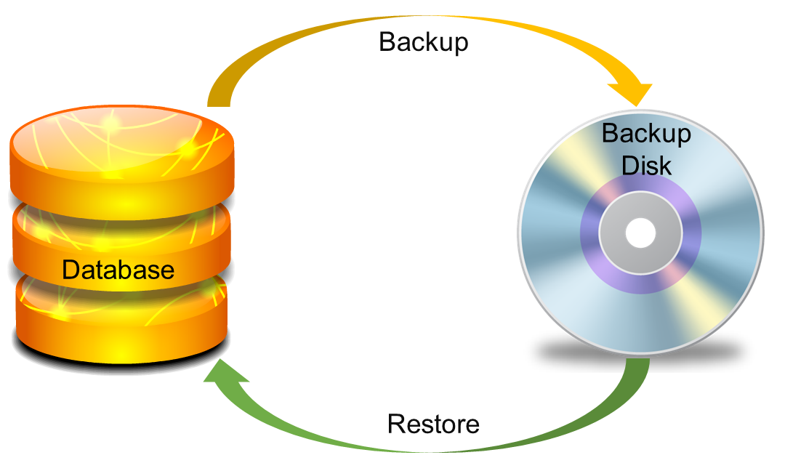
Providing backup and recovery services
Provides facilities to backup and restore the database in case of failure.

Slide 17
Advantages of DBMS (Summary)
Reduce data redundancy (duplication)
Avoids unnecessary duplication of data by storing data centrally.
Remove data inconsistency
By eliminating redundancy, data inconsistency can be removed.
Data isolation
A user can easily retrieve proper data as per his/her requirement.
Guaranteed atomicity
Either transaction executes 0% or 100%.

Slide 18
Advantages of DBMS (Summary)
Allow implementing integrity constraints
Business rules can be implemented such as do not allow to store amount less than Rs. 0 in balance.
Sharing of data among multiple users
More than one users can access same data at the same time.
Restricting unauthorized access to data
A user can only access data which is authorized to him/her.
Providing backup and recovery services
Can take a regular auto or manual backup and use it to restore the database if it corrupts.

Slide 19
Basic Terms

Slide 20
Basic terms of Database
Data
Data is raw, unorganized facts that need to be processed.
Example: Marks of students
Student_1 = 50/100, Student_2 = 25/100.
Information
When data is processed, organized, structured or presented in a given context so as to make it useful, it is called information.
Example: Result of students (Pass or Fail)
Student_1 = Pass, Student_2 = Fail.

Slide 21
Basic terms of Database
Metadata
Metadata is data about data.
Data such as table name, column name, data type, authorized user and user access privileges for any table is called metadata for that table.
Metadata of above table is:
Table name such as Faculty
Column name such as Emp_Name, Address, Mobile_No, Subject
Datatype such as Varchar, Decimal
Access privileges such as Read, Write (Update)
Faculty
Emp_Name | Address | Mobile | Subject
Prof. Amit Shah | Rajkot | 1234 | C lang.

Slide 22
Basic terms of Database
Data dictionary
A data dictionary is an information repository which contains metadata.
Table Name – Faculty
Column Name – Emp_Name, Address, Mob, Subject, Salary
Datatype – Varchar, Decimal
Access Privileges – Read, Write (Update)
Data warehouse
A data warehouse is an information repository which stores data.
Faculty
Emp_Name | Address | Mobile | Subject
Prof. Amit Shah | Rajkot | 1234 | C lang.
Prof. Ajay Patel | Rajkot | 9876 | C++
Exercise
Why data dictionary and data warehouse are stored in the different places?

Slide 23
Basic terms of Database
Field
A field is a character or group of characters that have a specific meaning.
E.g, the value of Emp_Name, Address, Mobile_No etc are all fields of Faculty table.
Faculty
Emp_Name | Address | Mobile | Subject
Prof. Amit Shah | Rajkot | 1234 | C lang.
Fields
Prof. Ajay Shah
Rajkot
1234
Record / Tuple
A record is a collection of logically related fields.
E.g, the collection of fields (Emp_Name, Address, Mobile_No, Subject) forms a record for the Faculty.
Prof. Amit Shah | Rajkot | 1234 | C lang.
Prof. Ajay Patel | Rajkot | 9876 | C++
Record / Tuple

Slide 24
Basic terms of Database
Instance
The data which is stored in the database at a particular moment of time is called an instance of the database.
Let’s say a table faculty in our database whose name is MU, suppose the table has 2 records so the instance of the database has 2 records.
Now we are going to add another one records so the instance have total 3 records.
The instances can be changed by certain CRUD operations as like addition, deletion of data.
Faculty
Emp_Name | Address | Mobile | Subject
Prof. Amit Shah | Rajkot | 1234 | C lang.
Prof. Jay Mehta | Surat | 9879 | C++
Prof. Jeet Oza | Baroda | 9876 | JAVA

Slide 25
Basic terms of Database
Schema
The overall design of a database is called schema.
The basic structure of how the data will be stored in the database is called schema.
Let’s say a table faculty in our database name DU, the faculty table require the emp_name, address, mobile, subject in their table so we design a structure as :
faculty table
emp_name : string
address: string
mobile : string
subject : string
Above given is the schema of the table faculty.
Faculty
Emp_Name | Address | Mobile | Subject
Prof. Amit Shah | Rajkot | 1234 | C lang.
Prof. Jay Mehta | Surat | 9879 | C++
A schema contains schema objects like table, foreign key, primary key, views, columns, data types, stored procedure, etc.

Slide 26
3 Levels
of Database System

Slide 27

3 Levels in Database System
User 1
User 2
User 3
How data are viewed by each users?
View 1
View 2
View 3
View
Level
What data are stored and
What relationships exist?
Conceptual
Level
Logical
Level
How the data are actually stored on storage devices?
Internal
Level
Physical
Level
Database

Slide 28
3 Levels in Database System
Internal level (Physical level)
It describes how a data is stored on the storage device.
Deals with physical storage of data.
Structure of records on disk - files, pages, blocks and indexes and ordering of records
Internal view is described by the internal schema.
Conceptual level (Logical level)
What data are stored and what relationships exist among those data?
It hides low level complexities of physical storage.
For Example, STUDENT database may contain STUDENT and COURSE tables which will be visible to users but users are unaware about their storage.
Database administrator works at this level to determine what data to keep in the database.
External level (View level)
It describes only part of the entire database that an end user concern or how data are viewed by each user.
Different user needs different views of the database, so there can be many views in a view level abstraction of the database. Used by end users and application programmers.
End users need to access only part of the database rather than the entire database.

Slide 29
3 Levels in Database System
We are storing student information in a student table.
User 1
User 2
User 3
User just interact with system with the help of GUI.
Users are not aware of how and what the data is stored.
View 1
View 2
View 3
View
Level
Records can be described as fields and attributes along with their data types, their relationship among each other can be logically implemented.
Programmers generally work at this level.
Conceptual
Level
Logical
Level
Internal
Level
Physical
Level
Records can be described as blocks of storage (bytes, gigabytes, terabytes etc.) in memory.
These details are often hidden from the programmers.
Database

Slide 30
Data Abstraction in DBMS
Database systems are made-up of complex data structures.
To ease the user interaction with database, the developers hide internal irrelevant details from users.
This process of hiding irrelevant details from user is called data abstraction.

Slide 31
Mapping and Data Independence
Want to access some data
User 1
User 2
User 3
View 1
View 2
View 3
View
Level
Request
Conceptual
Level
Logical
Level
Process of transforming requests and results between the three levels is called mapping.
Internal
Level
Physical
Level
Ability to modify a schema definition in one level without affecting a schema definition in the next higher level.
Result
Database

Slide 32
Types of Data Independence
Physical Data Independence
Physical Data Independence is the ability to modify the physical schema without requiring any change in logical (conceptual) schema and application programs.
Modifications at the internal levels are occasionally necessary to improve performance.
Possible modifications at internal levels are changes in file structures, compression techniques, hashing algorithms, storage devices, etc.
Logical Data Independence
Logical data independence is the ability to modify the conceptual schema without requiring any change in application programs.
Modification at the logical levels is necessary whenever the logical structure of the database is changed.
Application programs are heavily dependent on logical structures of the data they access. So any change in logical structure also requires programs to change.

Slide 33
Types of
Database Users

Slide 34
Types of Database Users
Naive Users (End Users)
Unsophisticated users who have zero knowledge of database system
End user interacts to database via sophisticated software or tools
e.g. Clerk in bank
Application Programmers
Programmers who write software using tools such as Java, .Net, PHP etc…
e.g. Software developers
Sophisticated Users
Interact with database system without using an application program
Use query tools like SQL
e.g. Analyst
Specialized Users (DBA)
User write specialized database applications program
Use administration tools
e.g. Database Administrator

Slide 35
Role of DBA (Database Administrator)

Slide 36
Role of DBA (Database Administrator)
Schema Definition
DBA defines the logical schema of the database.
Storage Structure and Access Method Definition
DBA decides how the data is to be represented in the database & how to access it.
Defining Security and Integrity Constraints
DBA decides on various security and integrity constraints.
Granting of Authorization for Data Access
DBA determines which user needs access to which part of the database.
Liaison with Users
DBA provide necessary data to the user.

Slide 37
Role of DBA (Database Administrator)
Assisting Application Programmer
DBA provides assistance to application programmers to develop application programs.
Monitoring Performance
DBA ensures that better performance is maintained by making a change in the physical or logical schema if required.
Backup and Recovery
DBA backing up the database on some storage devices such as DVD, CD or magnetic tape or remote servers and recover the system in case of failures, such as flood or virus attack from this backup.

Slide 38
Database System Architecture

Slide 39
Database System Architecture
Naive
user
Application programmer
Sophisticated
user
Database administrator
uses
write
uses
uses
Application
interfaces
Application
program
Query
tool
Administration tool
Query
processor
Interprets DDL statements into a set of tables containing metadata
Translates DML statements into low level instructions that the query evaluation engine understands
Executes low level instructions generated by DML compiler.
Compiler and linker
DML queries
DDL interpreter
Deals with execution of DDL and DML statements
Application program object code
DML compiler and organizer
Query evaluation engine
Storage
manager
Provides interface between low-level data stored and application program or queries
Buffer manager
File manager
Authorization and integrity manager
Transaction manager
Preserves atomicity and controls concurrency
Checks the authority of users to access data and integrity constraints
Manages allocation of space on disk storage
Fetches data from disk storage to memory for being used
Disk storage
Indices
Data dictionary
To provide faster access to data items
To store statistical information about the data
Data
Statistical data
To store metadata
To store user data

Slide 40
Data Models

Slide 41
Data Models
Data models define how the logical structure of a database is modeled.
It defines how data can be stored, accessed and updated in a database.
It also define how data is connected to each other and how they are processed and stored inside the system.
Data Models
Record Based Models
Object Based Models
Physical Data
Model
Hierarchical Model
Network Model
Relational Model
Entity Relational Model
Object Oriented Model

Slide 42
Hierarchical Model
Here tree concept is used to represent data and relationship among data.
Vehicle
Here each child record can have only one parent record.
Each parent record can have zero or more than one child record.
2 Wheeler
4 Wheeler
Records are represented by rectangular box and relationships between records are represented by arcs.
Bike
Scooter
Car
Tractor
Sedan
SUVs

Slide 43
Network Model
This model is an extension of the hierarchical model.
College
This model is the same as the hierarchical model, the only difference is that a record can have more than one parent.
Computer Engineering
Information & Communication Technology
Information Technology
It replaces the hierarchical tree with a graph in which object types are the nodes and relationships are the edges.
Principal

Slide 44
Rational Model
Relational Model is the most widely used model.
In this model, the database is represented as a collection of tables in the form of rows and columns of a two-dimensional table.
In this model, the data is maintained in the form of a two-dimensional table. All the information is stored in the form of row and columns.
The basic structure of a relational model is tables. So, the tables are also called relations in the relational model.
Each row is known as a tuple (a tuple contains all the data for an individual record) while each column represents an attribute.
Faculty
Emp_Name | Address | Mobile | Subject
Prof. Amit Shah | Rajkot | 1234 | C lang.
Prof. Jay Mehta | Surat | 9879 | C++
Prof. Raj Patel | Baroda | 9825 | Java

Slide 45
Entity Relational Model
In this model, we represent the real-world problem in the pictorial form to make it easy for the stakeholders to understand.
An ER model is the logical representation of data as objects and relationships among them. These objects are known as entities, and relationship is an association among these entities.
Entities: Entity is a real-world thing. It can be a person, place, or even a concept.
Example: Faculty, Students, Course, Department etc are some of the entities of a College Management System.
Attributes: An entity contains a real-world property called attribute. This is the characteristics of that attribute.
Example: The entity Faculty has the property like Name, Salary, Age, etc.
Relationship: Relationship tells how two attributes are related.
Example: Faculty teaches to the Students.
Entity
Relationship
Entity

Slide 46
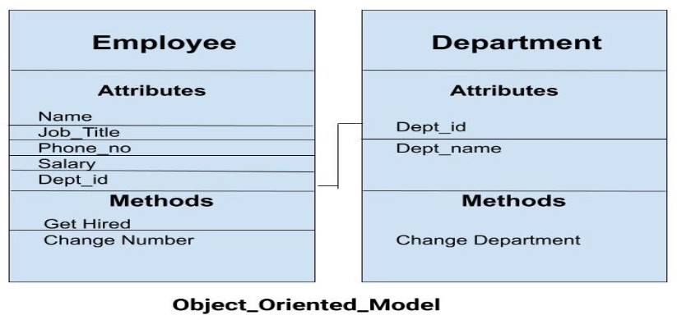
Object Oriented Model
This model is based on collection of objects.
We have two objects Employee and Department.
An object body consists of data as well as methods.
The attributes like Name, Job_title of the employee and the methods which will be performed by that object are stored as a single object.
The objects that contain same type of data and same type of function are group together as a class.
The two objects are connected through a common attribute i.e the Dept_id and the communication between these two will be done with the help of this common id.

Slide 47
Physical Data Model
Physical data models are used for a higher level description of storage structure and access mechanism.
They describe how data is stored in database.

Slide 48

Thank
You!!

